Slide 1

Snake Game
PPS PROJECT
By Dhatrish Bali
RA2111001010003

Slide 2
BASICS OF THE GAME
The snake is represented with a 0(zero) symbol.
The fruit is represented with an *(asterisk) symbol.
The snake can move in any direction according to the user with the help of the keyboard (W, A, S, D keys).
When the snake eats a fruit the score will increase by 10 points.
The fruit will generate automatically within the boundaries.
Whenever the snake will touch the boundry the game is over.

Slide 3
STEPS
There will be four user-defined functions.
Build a boundary within which the game will be played.
The fruits are generated randomly.
Then increase the score whenever the snake eats a fruit.

Slide 4
USER DEFINED FUNCTIONS
Draw(): This function creates the boundary in which the game will be played.
1
Setup(): This function will set the position of the fruit within the boundary.
2
Input(): This function will take the input from the keyboard.
3
Logic(): This function will set the movement of the snake.
4

Slide 5
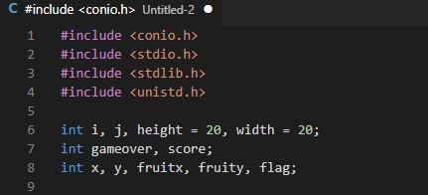
The header file and Variable used in this programe

Slide 6
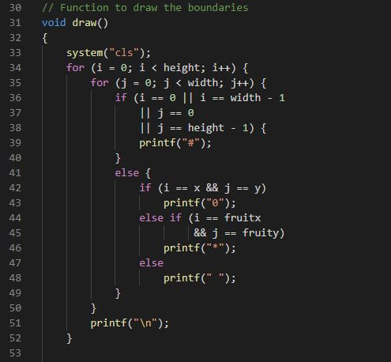
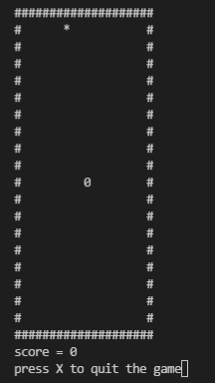
raw(): This function is responsible to build the boundary within which the game will be played.

Slide 7
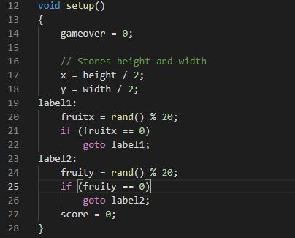
setup():nThisbfunction is used to write the code to generate the fruit within the boundary using rand() function.
Using rand()%20 because the size of the boundary is length = 20 and width = 20 so the fruit will generate within the boundary.

Slide 8
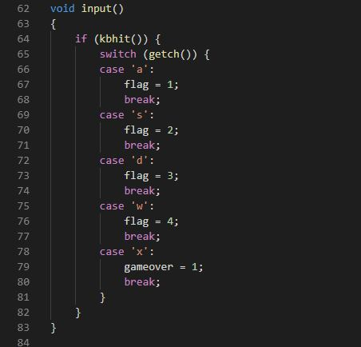
Input(): In this function, the programmer writes the code to take the input from the keyboard (W, A, S, D, X keys).

Slide 9
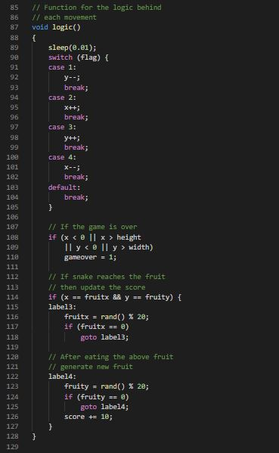
logic(): Here, write all the logic for this program like for the movement of the snake, for increasing the score, when the snake will touch the boundary the game will be over, to exit the game and the random generation of the fruit once the snake will eat the fruit.

Slide 10
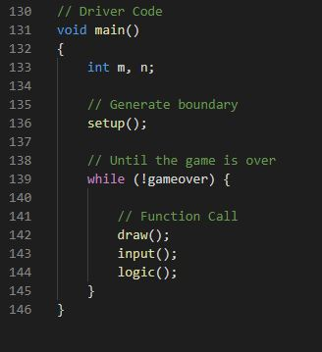
sleep(): This function in C is a function that delays the program execution for the given number of seconds. In this code sleep() is used to slow down the movement of the snake so it will be easy for the user to play.

Slide 11
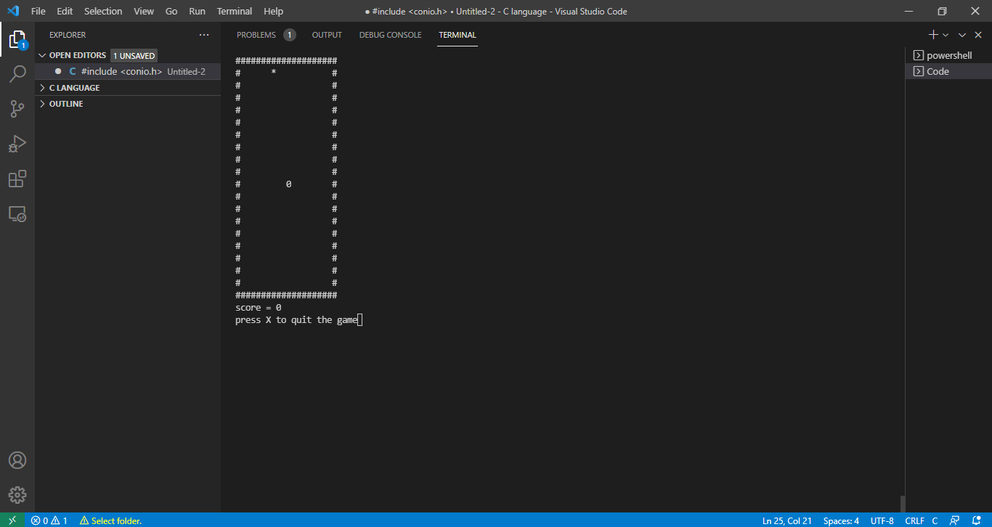
THE FINAL PRODUCT

